Slide 1
3D Object Detection using unsupervised machine learning for point clouds
BY : SHYAMSUNDAR SUDHARSANAM
SUPERVISOR:

Slide 2
Table of contents
Project Scope
KITTI Dataset
Pipeline for 3D object detection
Pre processing
RANSAC
DBSCAN
3D bounding box

Slide 3
Project Scope
There are approaches for 3D object detection like Deep Learning or traditional algorithms. In deep learning we can use Voxel based , pillar based , point based , these methods require significant amount of training data and GPU to provide high accuracy required for Self Driving cars. These are considered as supervised machine learning
In this project, we use traditional methods such as DBSCAN, RANSAC to generate 3D bounding boxes in unsupervised machine learning.
KITTI dataset was used in this project

Slide 4
KITTI Dataset
Consists of 7481 training images and 7518 test images . It consist of classes such as car, pedestrian and cyclists which is the three important classes for object detection
In this project , I have taken 53 images from training data , and there is no necessity for having training folder in unsupervised machine learning
In kitti lidar data are stored in .bin and this to be converted to pcd for processing in open3d

Slide 5
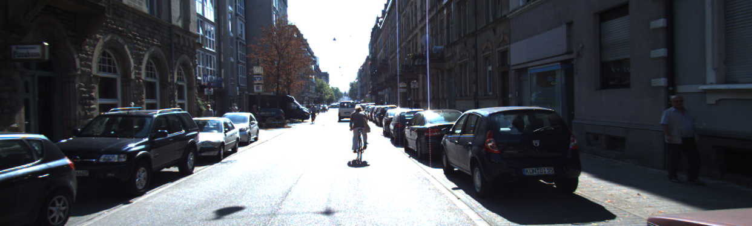
SAMPLE INPUT IMAGE

Slide 6
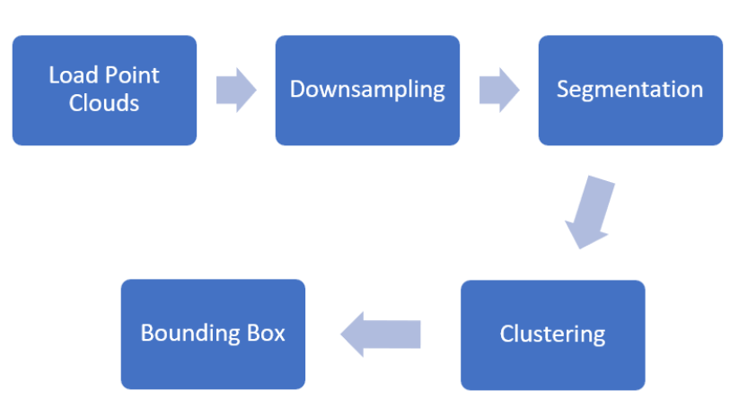
PIPELINE FOR 3D OBJECT DETECTION

Slide 7
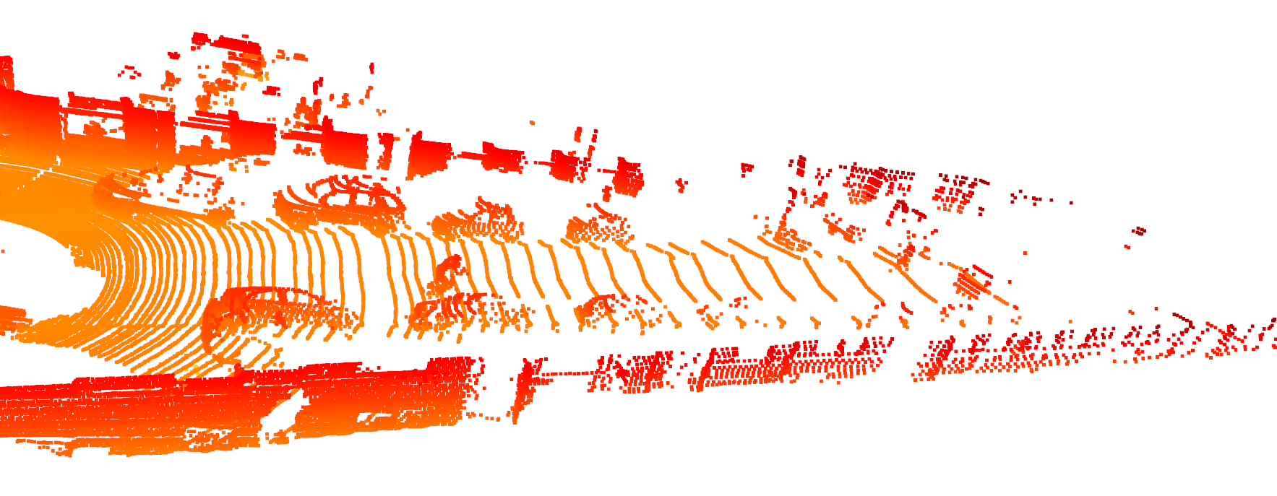
Voxel downsampling
Reduce number of points and maintaining object structure with voxel grid
Only one point per cube is present , increasing size of cube reduces significant reduction in points

Slide 8
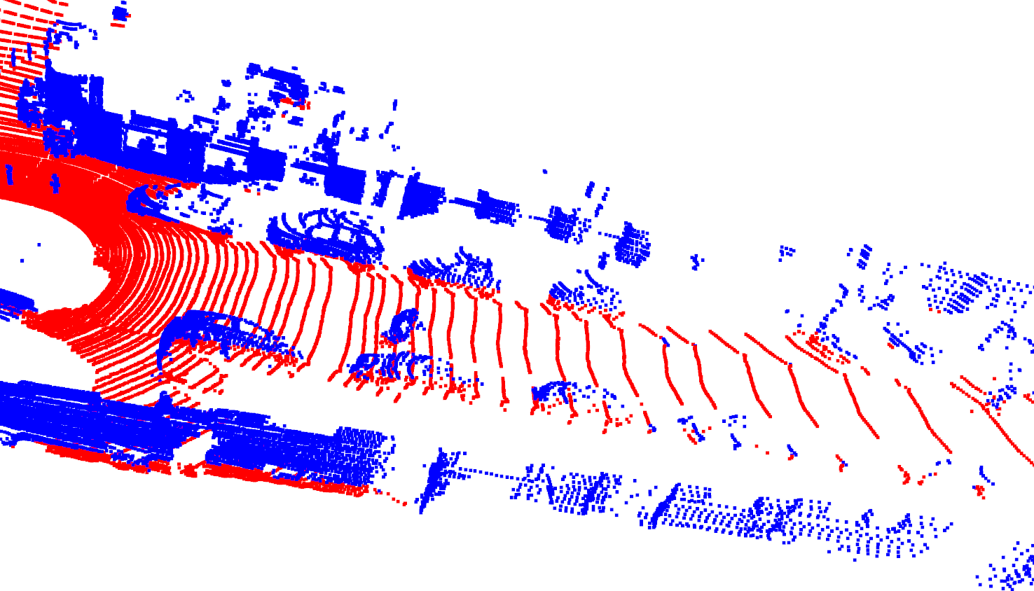
SEGMENTATION RANSAC
Segmentation is done with RANSAC, as road has more points it is considered as inliers and the pedestrian, cycle and cars are outliers
Parameters : no of points : 3 iterations : 250 distance threshold : 0.3

Slide 9
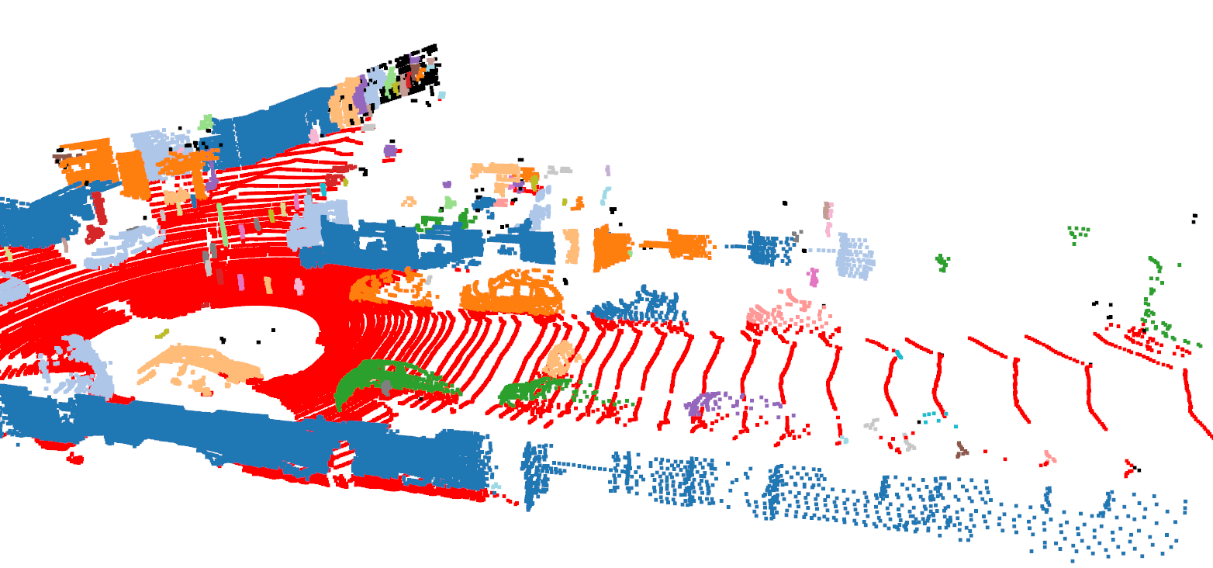
CLUSTERING DBSCAN
Pedestrian, bicyclist , car are different size , hence we cannot use KMEANS and use DBSCAN.
Parameters: Minimum points : 5 Epsilon : 0.5

Slide 10
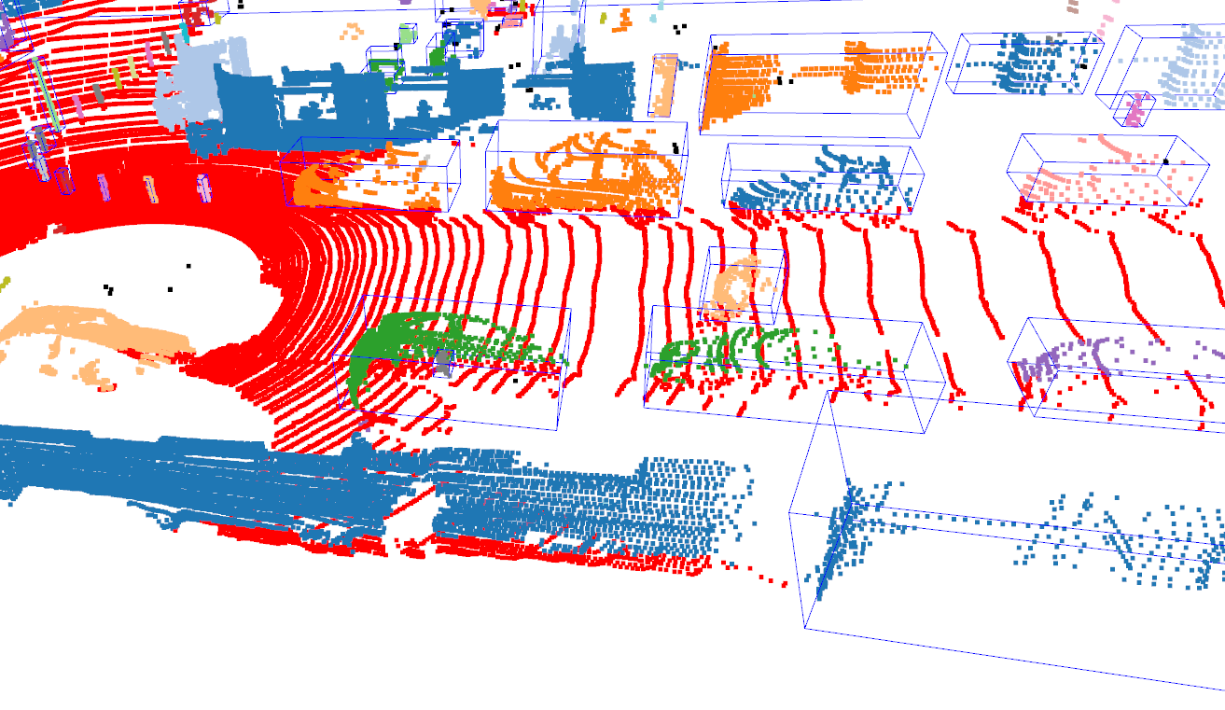
BOUNDING BOX
Minimum and maximum points are considered to form the bounding box. These points are acquired using index of clusters in open3d and thereby we can find the bounding box.

Slide 11
PROBLEMS
This method is not working in all cases of point cloud , as it has high false positives

Slide 12
Thank you FOR YOUR ATTENTION..
Please feel free to ask , if you have any questions

